Slide 1
St. Patrick’s Celebration March 15, 2025
benefitting: The ACDS Foundation

Slide 2
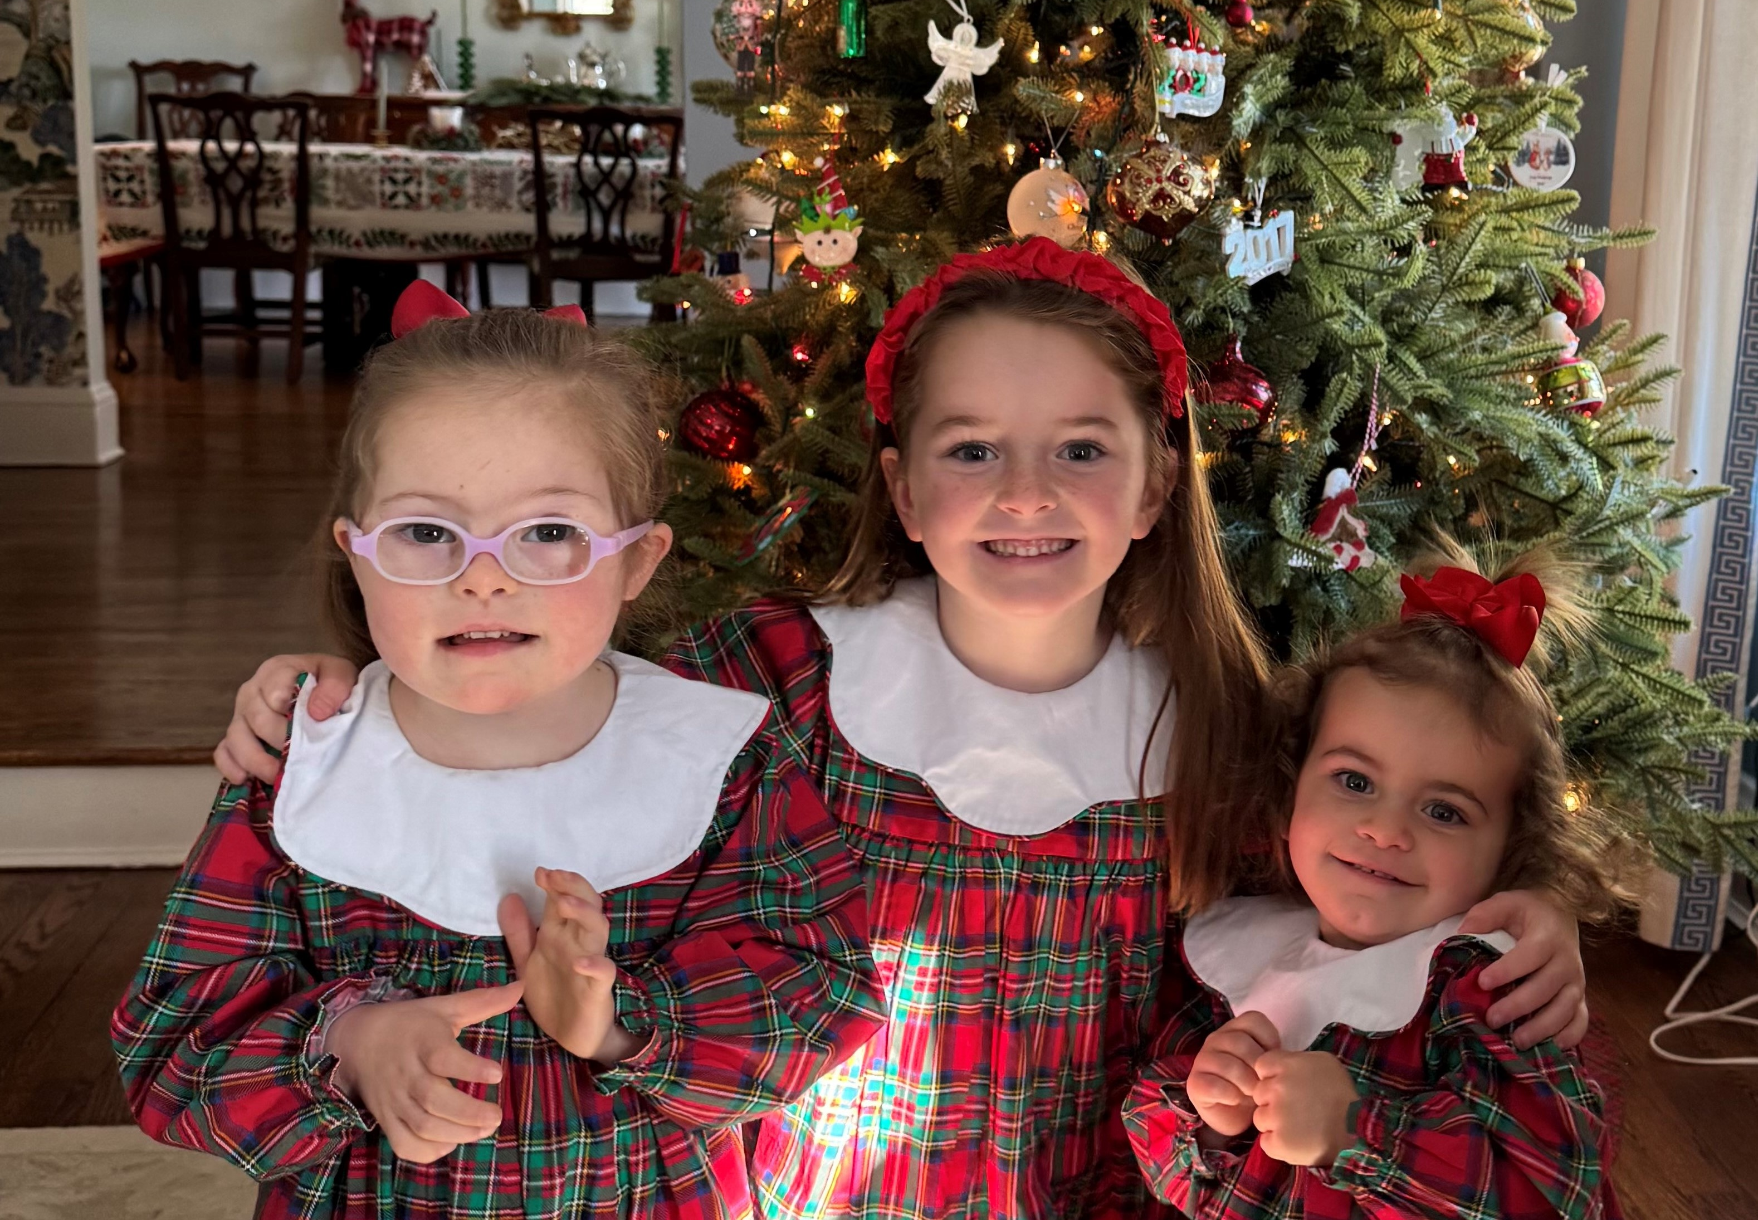
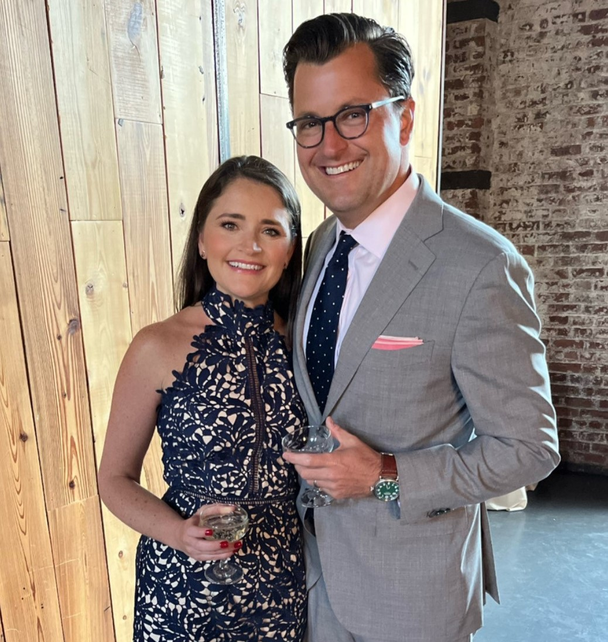
Honoring: Natalie Carey ACDS Mom

Slide 3
event Sponsor

Slide 4
event Sponsor
Carmine & Lynda Rubino

Slide 5
event Sponsor

Slide 6
Shamrock Sponsor

Slide 7
Shamrock Sponsor
Hugh O’Connell

Slide 8
Entertainment Underwriter
Elena & Roger O’Donnell

Slide 9
Guinness Sponsor

Slide 10
Guinness Sponsor

Slide 11
Guinness Sponsor

Slide 12
GROUP HOME Sponsor

Slide 13
GROUP HOME Sponsor
Michael Farrell

Slide 14
GROUP HOME Sponsor
Raymond James®
JoAnne Irace Duffy, Branch Manager

Slide 15
GROUP HOME Sponsor
Michael & Stacey Miller

Slide 16
GROUP HOME Sponsor
Elena & Roger O’Donnell

Slide 17
Jameson’s Sponsor

Slide 18
Bailey’s Sponsor
Gus & Mary Nuzzolese

Slide 19
Proudly supports ACDS
pooo

Slide 20
Special Thanks to
Hagen Kavanagh
School of Irish Dance

Slide 21
Many thanks to the St. Patrick’s Celebration Planning Committee
Liz Campbell
Michael Farrell
Tiana Jones
Tracy Kirley
Jane Shimkin
Tommy Ryan

Slide 22
Many thanks to our
Volunteers
without whom this evening wouldn’t be possible

Slide 23
SAVE THE DATE
JULY 21, 2025

